Slide 1

CENG 789 – Digital Geometry Processing
02- Polygons and Triangulations
Assoc. Prof. Yusuf Sahillioğlu
Computer Eng. Dept, , Turkey

Slide 2
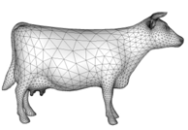
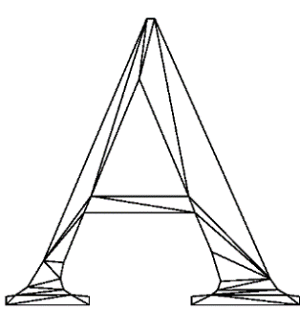
Polygons
<number> / 35
We’ll deal with thin-shell surfaces, represented by polygon meshes.
  set of polygons, e.g., triangles, representing a 2D surface embedded in 3D.
  set of polygons representing a 2D surface embedded in 2D //not our interest.
Let’s analyze polygons in detail.

Slide 3


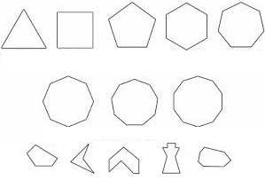

Polygons
<number> / 35
Analogy
  ~
~
Polygons are to planar geometry as integers are to numerical math.

Slide 4


Polygons
<number> / 35
Analogy
  ~ Prime factorization (unique)
. . ~ Prime factorization (not unique*)
* no benefit of Fundamental Theorem of Arithmetic
Triangulations are the prime factorization of polygons (come to that later).

Slide 5





Polygons
<number> / 35
Polygon: closed region of the plane bounded by a finite collection of line segments forming a closed curve that does not intersect itself.
Line segments are called edges.
Points where 2 edges meet are called vertices.
Vertices are ordered in a polygon.
3D generalization: polyhedron. //some cool theorems proved in the first class: 01-intro.ppt

Slide 6
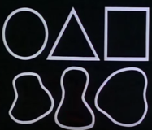
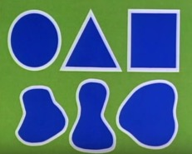
Polygonal Jordan Curve Thm
<number> / 35
Theorem: boundary B (white) of a polygon P partitions the plane into 2 parts, namely bounded interior (b) and unbounded exterior (g).
Intuition: Shows the Fundamental similarity between all polygons!
Each form above divides the paper into an inside part (blue) and an outside part (green).

Slide 7





Polygonal Jordan Curve Thm
<number> / 35
Theorem: boundary B (white) of a polygon P partitions the plane into 2 parts, namely bounded interior (b) and unbounded exterior (g).
A point that lies in 1 part cannot get to the other no matter how the curve/boundary is stretched.

Slide 8



Polygonal Jordan Curve Thm
<number> / 35
Theorem: boundary B (white) of a polygon P partitions the plane into 2 parts, namely bounded interior (b) and unbounded exterior (g).
A point that lies in 1 part cannot get to the other no matter how the curve/boundary is stretched.
It will behave the same no matter how the boundary is distorted.

Slide 9
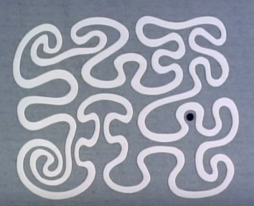
Polygonal Jordan Curve Thm
<number> / 35
Theorem: boundary B (white) of a polygon P partitions the plane into 2 parts, namely bounded interior (b) and unbounded exterior (g).
A point that lies in 1 part cannot get to the other no matter how the curve/boundary is stretched.
Now it is more difficult to tell whether point x is inside or outside. But wait there is an easy way!

Slide 10
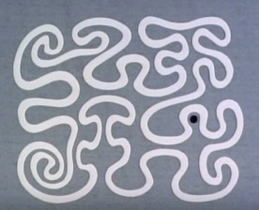
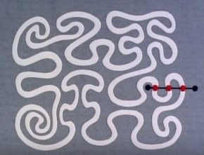
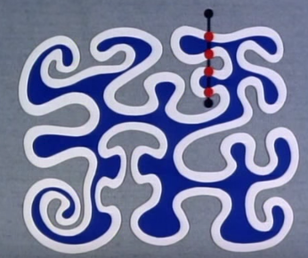
Polygonal Jordan Curve Thm
<number> / 35
Theorem: boundary B (white) of a polygon P partitions the plane into 2 parts, namely bounded interior (b) and unbounded exterior (g).
In/Out: draw a line from x to infinity(this line not parallel to any edge of P; ok ‘cos P has finite # edges).
If line intersects B odd # of times: x is inside.
Else: x is outside.
Holds for arbitrary x.

Slide 11
Polygonal Jordan Curve Thm
<number> / 35
Theorem: boundary B (white) of a polygon P partitions the plane into 2 parts, namely bounded interior (b) and unbounded exterior (g).
Observation: the trivial odd-even algorithm is triggered to decided whether a user clicks inside a region in a game or a button in a GUI.

Slide 12


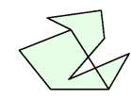

Diagonal
<number> / 35
Diagonal of polygon P is a line segment connecting 2 vertices of P and lying in the interior of P.
P with a diagonal a line segment crossing diagonals

Slide 13
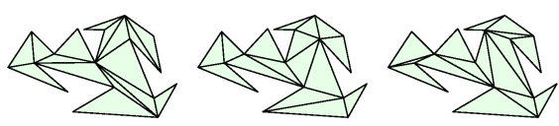
Triangulation
<number> / 35
Triangulation of polygon P is a decomposition of P into triangles by a maximal set of noncrossing diagonals.
Maximal: no new diagonal may be added without crossing existings.
Easier than triangulation of a structureless point set, e.g., Delaunay.
  We will see this general case later; now just assume we have the boundary as an ordered set of vertices, i.e., as polygon P.

Slide 14
Triangulation
<number> / 35
How many different triangulations does polygon P have?
How many triangles are in each triangulation of P?
Does every polygon have a triangulation?
Must every polygon have at least 1 diagonal?

Slide 15
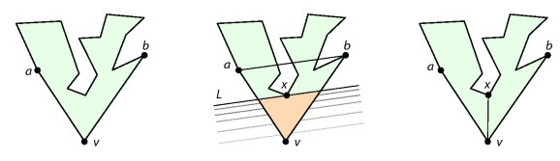
Triangulation
<number> / 35
Must every polygon w/ 4+ vertices have at least 1 diagonal?
  YES.
Proof: v bottom vertex. a & b adjacent to v. If line segment ab lies in P, it is the diagonal. Else sweep line L from v towards ab, parallel to ab. x first vertex L touches. vx is the desired diagonal.

Slide 16
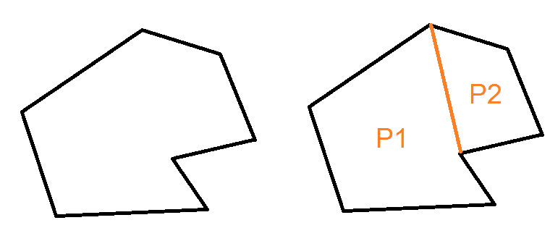
Triangulation
<number> / 35
Does every polygon have a triangulation?
  YES.
Proof: Induct on n = # of vertices of P. If n=3, P=triangle; done. For n>3, use prev theorem to find a diagonal cutting P into P1 and P2, which are triangulatable by induction hypothesis. By Jordan theorem, interior of P1 is exterior of P2 and vice versa; hence no triangle overlap.

Slide 17

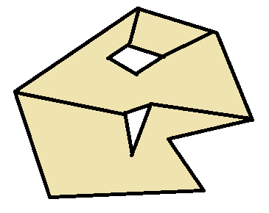
Triangulation
<number> / 35
Does every polygonal region w/ holes have a triangulation?
  YES.
Proof: Induct on h = # of holes.

Slide 18
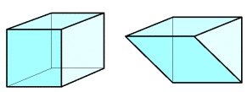
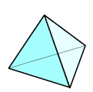
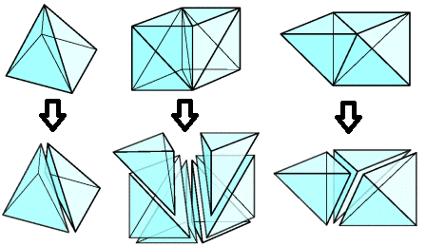
Triangulation
<number> / 35
Does every polyhedron have a tetrahedralization?
  NO.
  Polyhedron: 3D version of a polygon, a 3D solid bounded by finitely many polygons.
  Tetrahedron: simplest polyhedron; pyramid with a triangular base.
  Tetrahedralization: partition of a polyhedron into tets.

Slide 19
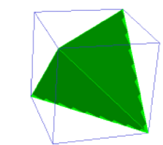
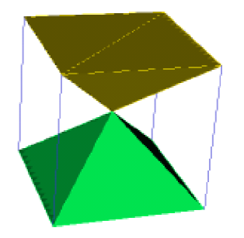
Triangulation
<number> / 35
Does every polyhedron have a tetrahedralization?
  NO.
  Tetrahedralization of a cube into 5 and 12 tetrahedra.
  Related read: There are 174 Subdivisions of the Hexahedron into Tetrahedra, SIGGRAPH Asia 2018.

Slide 20
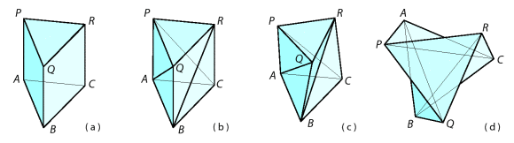
Triangulation
<number> / 35
Does every polyhedron have a tetrahedralization?
  NO. A counter example exists: Schonhardt polyhedron.
  Notice that all possible diagonals are external.

Slide 21
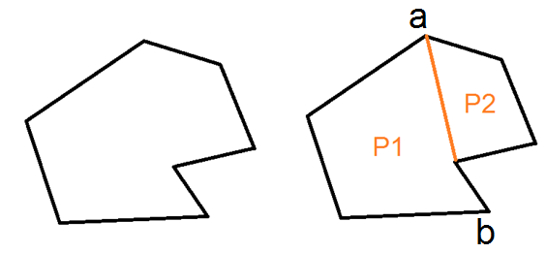
Triangulation
<number> / 35
Number of triangles in any triangulation of a polygon P is the same and equal to n-2 if P has n vertices.
Proof: Induct on n = # of vertices of P. If n=3, trivially true. Diagonal ab exists. P1 and P2 have n1 and n2 vertices. n1 + n2 = n + 2 ‘cos a and b appear in both P1 and P2. By induction hypo, there are n1-2 and n2-2 triangles in P1 and P2. Hence P has
  (n1-2) + (n2-2) = n1+n2 – 4 = n+2 – 4 = n - 2 triangles.

Slide 22
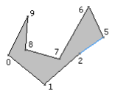
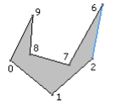
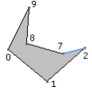
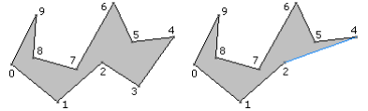
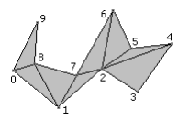




Triangulation
<number> / 35
Ears: 3 consecutive vertices a b c form ear of P if ac is a diagonal.
(our 1st triangulation algo
  aka ear clipping method )
Every polygon w/ 4+ vertices has at least 2 ears.
Proof: By prev thm P has n-2 triangles. Each tri covers at most 2 edges of boundary. Because there’re n edges on boundary but only n-2 tris, at least 2 tris must contain 2 edges of boundary (assume each tri covers 1; n-2 covered; need +2). These are the ears.

Slide 23
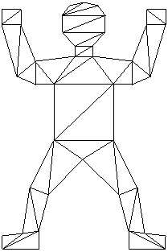
Triangulation
<number> / 35
Sum of interior angles of any polygon with n vertices is pi(n-2).
Proof: every triangulation has n-2 triangles and sum of each tri is pi.

Slide 24
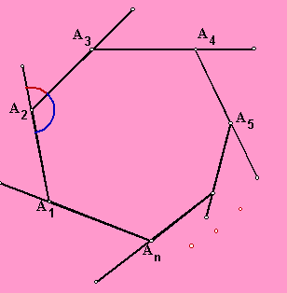
Triangulation
<number> / 35
Sum of turn angles of any polygon with n vertices is 2pi. Turn angle at a vertex is pi – internal angle at v.
Proof: Follows from npi – (n-2)pi = 2pi.

Slide 25

Triangulation
<number> / 35
How many different triangulations does polygon P have?
  No closed formula ‘cos small position changes can lead to different triangulatns.
Find a polygon with n vertices that has a unique triangulation.
  3 convex vertices and a reflex chain of n-3 vertices, generalizing:
  A vertex is convex/reflex if its angle is
  less than or equal to/greater than pi.
A polygon is convex if all its vertices are convex. Or equivalently, if every pair of nonadjacent vertices determines a diagonal.
How many different triangulations does a convex polygon P have?
  n+2 vertices P has C_{n} (Catalan number) triangulations.

Slide 26

Triangulation
<number> / 35
How many different triangulations do these polygons have?
1 2 2
Find a polygon with n vertices that has exactly 2 triangulations.
  Hint: and a rectangle.

Slide 27
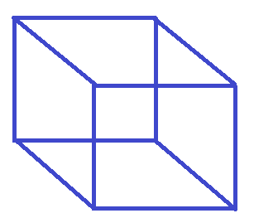

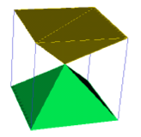
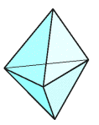
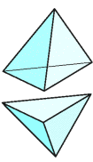
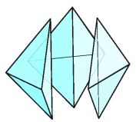
Triangulation
<number> / 35
Recall in 2D every polygon with n vertices has the same # of triangles in any triangulations: n-2 triangles.
How about polyhedra in 3D?
  Not valid ☹ Two different tetrahedralizations of the same polyhedron have different # of tets:
  OR

Slide 28
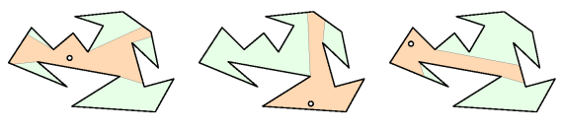
Art Gallery Problem
<number> / 35
Min # of stationary guards needed to protect the gallery.
Polygonal floor plan of the gallery.
Each guard has 360 degree visibility.
Protect: every point in P is visible to some guard.
x in P is visible to y in P if line segment xy lies in P.

Slide 29

Art Gallery Problem
<number> / 35
Min # of guards to protect/cover these polygons.
3 1 1 2

Slide 30
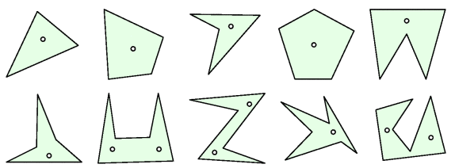
Art Gallery Problem
<number> / 35
First time 2 guides are needed is for some hexagons.

Slide 31
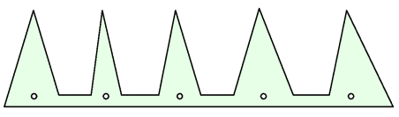
Art Gallery Problem
<number> / 35
Bound that is good for any polygon with n vertices?
Reflex vertices will cause problems w/ large # of vertices.
Since there can exist so many reflexes construct a useful example based on prongs: a comb-shaped example.
A comb of m prongs has 3m vertices.
Since each prong needs its own gard, at least floor(n/3) guards needed.
Lower bound: sometimes floor(n/3) guards necessary.
Is this also sufficient? (yes)

Slide 32
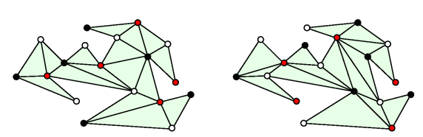
Art Gallery Problem
<number> / 35
Is floor(n/3) guards also sufficient to cover n-vertex polygon?
= Is this also an upper bound?
Trick: triangulation as 1 guard clearly covers a triangle.
We have n-2 triangles so is n-2 the upper bound?
  Not too tight ☹.
Put guards not inside the triangles but on the vertices.

Slide 33
Art Gallery Problem
<number> / 35
Use induction to prove any triangulation of P is 3-colorable: each vert of P can be assigned a color so that any connected pair has different color.
Induct on n = # of vertices. For n=3, trivially true. For n>3, we know P has an ear abc with b as tip. Removing the ear produces a P’ w/ n-1 vertices where b is removed. By induction hypo, P’ is 3-colorable. Replacing the ear, coloring b with the color not used by a or c, provides the desired coloring.

Slide 34
Art Gallery Problem
<number> / 35
Since there’re n vertices, the least frequently used color appears at most floor(n/3) times (pigeonhole principle). Put guards at these verts.
Since every triangle has 1 vertex of this color, and this guard covers the triangle, gallery is completely covered (with at most floor(n/3) guards).
  If I had used 4 colors, then a 3-vertex triangle might be missing that least-freq color; but I guarantee to use 3 colors so all triangles are definitely covered.
n=18; least-freq color red is used 5 times.

Slide 35
Potential Project Topic
<number> / 35
Implement the polygon interpolation paper: Shape Blending Using the Star-Skeleton Representation.
Implement the 3D Art Gallery paper: Computing 3D Shape Guarding and Star Decomposition.

